Slide 1

An experiment on the effects of the anti-anxiety drug on memory recovery
Science Faculty of computing engineering and the built environment
MSc. Advanced Computer Science
Module: Advanced Data Science
Code: CMP7161
Module Leader: Yevgeniya Kovalchuk
Student: Filip Paskalev
Number: S19155623
Academic year 2019/2020

Slide 2
Science Faculty of computing engineering and the built environment
MSc. Advanced Computer Science
ABSTRACT
The report is over an experiment on the effects of anti-anxiety medicament on memory recall when being primed with happy or sad memories. The focus of the analysis is on the placebo effect and the effect of anti-anxiety medicine on memory recall. Data set is created from the data of participants in the experiment, done on novel Islanders who mimic real-life humans in response to external factors. The experiment was executed under the supervision of Mr. Almohalwas at UCLA. All aspects of the experiment such as experimental design, data collection, and preprocessing were done from Steve Ahn.
Academic year 2019/2020

Slide 3
Dataset description and the problem to be addressed
Science Faculty of computing engineering and the built environment
MSc. Advanced Computer Science
Data containing Islander general, drug, and test information.
Columns:
first_name: First name of Islander.
last_name: Last name of Islander.
age: Age of Islander.
Happy_Sad_group: Happy or Sad Memory priming block.
Dosage: 1-3 to indicate the level of dosage (low - medium - over recommended daily intake).
Drug: Type of Drug administered to Islander.
Mem_Score_Before: Seconds - how long it took to finish a memory test before drug exposure.
Mem_Score_After: Seconds - how long it took to finish a memory test after addiction achieved.
Diff: Seconds - difference between memory score before and after.
Academic year 2019/2020

Slide 4
Dataset description and the problem to be addressed
Science Faculty of computing engineering and the built environment
MSc. Advanced Computer Science
How does anti-anxiety medicine affect you differently by age?
Is there a level of plateauing in effectiveness of anti-anxiety medicine - if so, at what point?
Effect of anti-anxiety medicine on memory recall? Effectiveness of placebos in a test environment?
Academic year 2019/2020

Slide 5
Summary of data pre-processing and/or feature selection
Science Faculty of computing engineering and the built environment
MSc. Advanced Computer Science
Check what type are the fields in the data.
Remove or handle attributes with empty value
Check if data have any NULL values or missing values.
Label all data fields
Convert some of the fields in smaller units – int64 to int32
Create one more field with age category based on age of the person
Encode all the fields
Medicament field can be separate on three fields. Aim of that is to make deeper analysis of placebo effect.
Concatenate first name & second name
Academic year 2019/2020

Slide 6
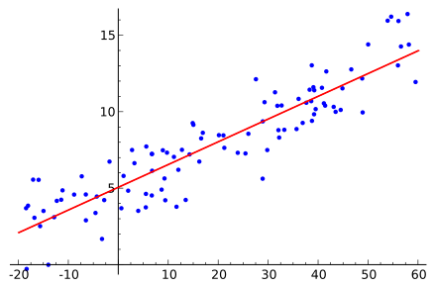
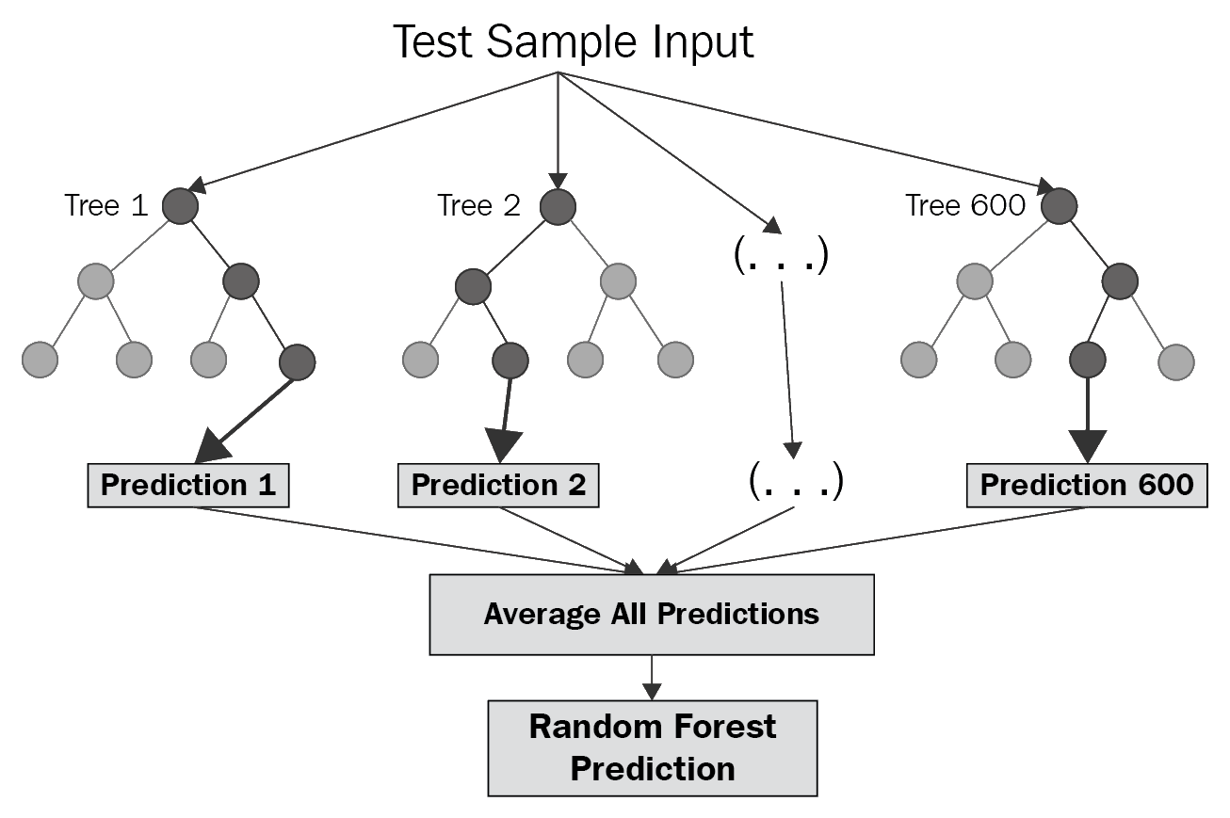
Description of the models built, their evaluation and comparison
Science Faculty of computing engineering and the built environment
MSc. Advanced Computer Science
Simple linear regression
Random forest regression
Academic year 2019/2020

